Slide 1

Data Communication CSE 315
Dr. A.K.M. Muzahidul Islam
Professor
Computer Science & Engineering (CSE)
United International University (UIU)
Fall 2018

Slide 2
About Me
Doctor of Engineering (Japanese Government Monbusho Scholarship) (04 Years)
Nagoya Institute of Technology (NiTech), Nagoya, Japan
Completed HSC (12 Years of Schooling)
Notre Dame College, Dhaka, Bangladesh
Completed MSc in Engineering (5-Year Russian Education System)
Kharkiv State of University of Radio Electronics, Kharkov, Ukraine
Completed University Foundadation Programme (01 Year)
Moscow State University of Railway and Engineering (MIIT), Moscow, Russia
1990
1992
1993
1994
1994
1999
2002
2007
Notes:
Before I move to my talk I would like to show my biography. …..

Slide 3
Senior Officer, IT Division
First Security Bank Ltd., Dhaka, Bangladesh
Professor
United International University (UIU)
Associate Professor & Head of CSE Department University of Liberal Arts Bangladesh (ULAB)
Senior Lecturer (Assistant Professor)
University Technology Malaysia (UTM)
Programmer & Network Engineering
Nagoya, Japan
~
2018
2018
2017
2017
2011
2010
2007
2002
1999
Notes:
Before I move to my talk I would like to show my biography. …..

Slide 4
Schedule
Section ‘B’
Sat/Tuesday
11:40 a.m.~ 1:10 p.m.
Room No. 0332 (Level 3)
Counseling
12:00 p.m.~ 13:00 p.m.
14:00 p.m.~ 15:00 p.m.
Room No. 333/D (Level 3)
Section ‘C’
Sun/Wednesday
1:30 p.m.~ 3:00 p.m.
Room No. 0328 (Level 3)
Counseling
12:00 p.m.~ 13:00 p.m.
14:00 p.m.~ 15:00 p.m.
Room No. 333/D (Level 3)

Slide 5
Assessment
Attendance : 5%
Assignments : 5%
Class Tests : 20%
Mid Term : 30%
Final : 40%
Grading Policy
A (Plain) : 90-100 C+ (Plus) : 70-73
A- (Minus) : 86-89 C (Plain) : 66-69
B+ (Plus) : 82-85 C- (Minus) : 62-65
B (Plain) : 78-81 D+ (Plus) : 58-61
B- (Minus) : 74-77 D (Plain) : 55-57

Slide 6
Resources
Data Communications and Networking. Behrouz A. Forouzan
Data and Computer Communications. William Stallings (TENTH EDITION)
Modern Digitial and Analog Communication Systems. BP-Lathi Zhi Ding (4th edition)
Computer Networks Andrew S. Tanenbaum

Slide 7
Outline
Introduction to Data Communication
Introduction to Networking
Introduction to OSI Layer and TCP/IP Layer
Introduction to IP Addressing

Slide 8
Data Communication
The fundamental purpose of a communication system is the exchange of data between two entities.
E.g., Browsing through the Internet, PC-Laptop data transfer, etc.
When we communicate we share information
Local sharing, e.g. face-to-face
Remote sharing, e.g. over some distance
Data
Information being shared, e.g. text, numbers, images, audio, video, etc.
Data communication
Exchange of data between two (or more) devices
Via some form of transmission medium
Fundamental requirements of data communication
Delivery - Accuracy - Timeliness
Telecommunication: communication at a distance

Slide 9
Effective Data Communication
The effectiveness of a data communications system depends on three fundamental characteristics:
Delivery : The data must be delivered to the
correct destination.
Accuracy : The data received must be
accurate representation of the data sent.
Timeliness : The data should be delivered with in a reasonable time.

Slide 10
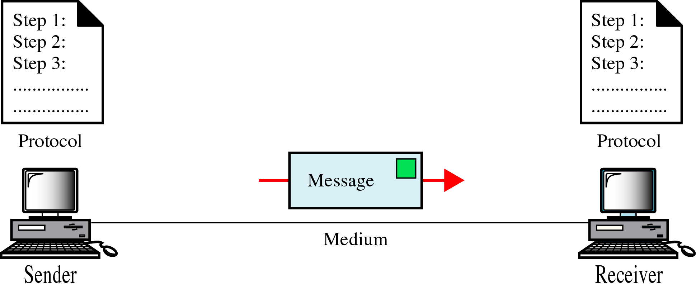
Components of Data Communication
Message: Information (data) to be communicated
Sender : the device that sends the data message
Receiver: the device that receives the data message
Medium: Physical path by which a message travels
Protocol: A set of rules that govern data communication

Slide 11
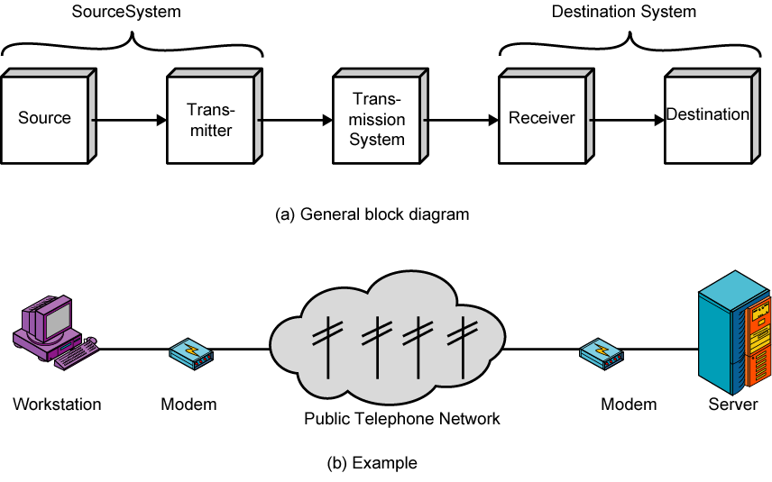
Communications Model - Diagram
A Simple Model of Communication, illustrated by the Block Diagram
Communication between workstation and Server

Slide 12
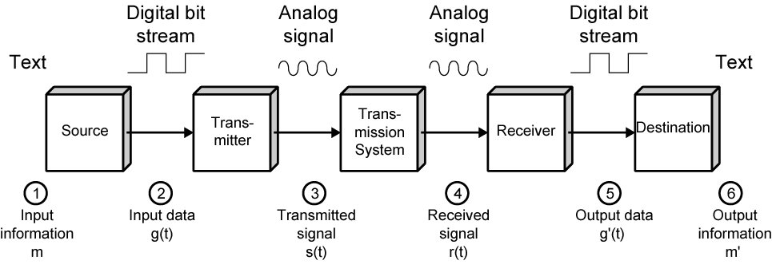
Simplified Communications Model
Details of a Communication Model given using Electronic Mail as an Example

Slide 13
Model Elements
The following are the key elements of the model:
Source : Generates data to be transmitted
Transmitter : Converts data into transmittable signals
Transmission
System : Carries data
Receiver : Converts received signal into data
Destination : Takes incoming data

Slide 14
Communications Tasks
The simple narrative conceals a wealth of technical complexity. The table below shows the lists of some of the key tasks that must be performed in a data communication.
Transmission system utilization | Addressing
Interfacing | Routing
Signal generation | Recovery
Synchronization | Message formatting
Exchange management | Security
Error detection and correction | Network management
Flow control

Slide 15
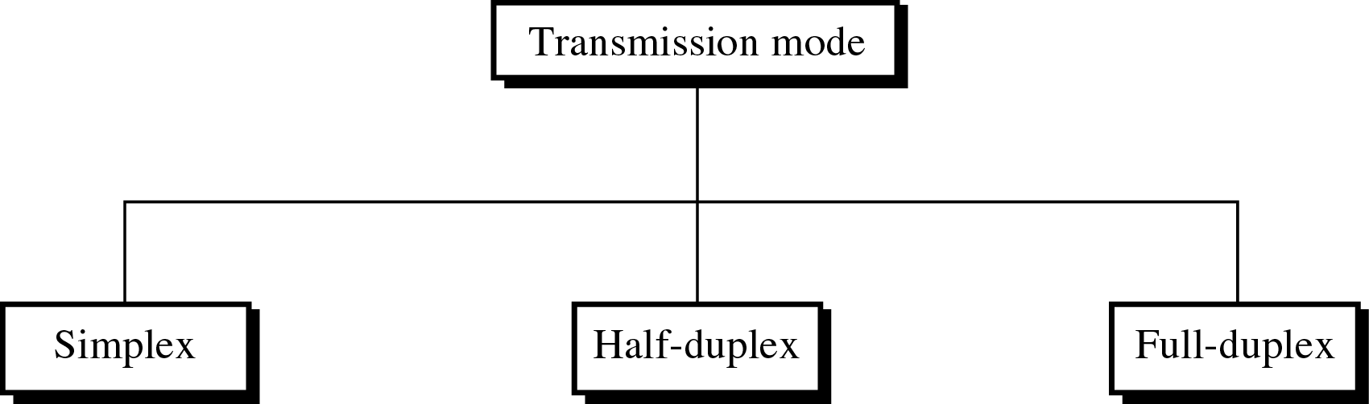
Direction of Data Flow
Communication between two devices can be:
Simplex : Unidirectional communication e.g. one- way street
Half-duplex : Each station can transmit and receive
but not at the same time
Full-duplex : Both station can transmit and receive simultaneously

Slide 16
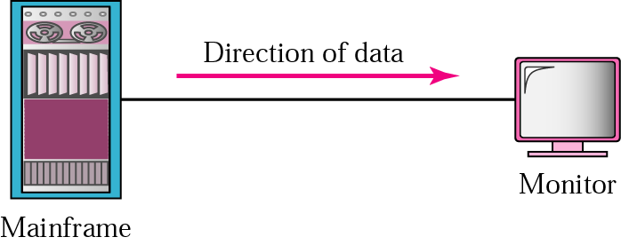


Simplex/Half-duplex/Full-duplex
Unidirectional
As on a one-way street
Both transmit and receive possible, but not at the same time
Like a one-lane road with two-directional traffic
Walkie-talkie
Transmit and receive simultaneously
Like a two-way street
Telephone

Slide 17
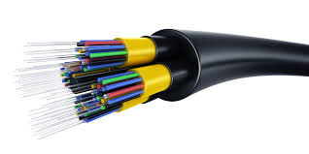
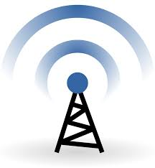
Transmission Medium
The basic building block of any communications facility is the transmission line.
One of the basic choices facing a business user is the Transmission Medium.
Internal use entirely up to business
Long-distance links made by carrier
Rapid technology advances change mix media used
Fiber optic
Wireless
Transmission costs still high
Hence interest in efficiency improvements
Notes:
The basic building block of any communications facility is the transmission line.
One of the basic choices facing a business user is the transmission medium. For use within the business premises, this choice is generally completely up to the business. For long-distance communications, the choice is generally but not always made by the long-distance carrier.
In either case, changes in technology are rapidly changing the mix of media used. The ever-increasing capacity of fiber optic channels is making channel capacity a virtually free resource. However, switching is now becoming the bottleneck. The growing use of wireless transmission, is a result of the trend toward universal personal telecommunications and universal access to communications.
Despite the growth in the capacity and the drop in cost of transmission facilities, transmission services remain the most costly component of a communications budget for most businesses. Thus, the manager needs to be aware of techniques that increase the efficiency of the use of these facilities, such as multiplexing and compression.
Fiber-optic communication is a method of transmitting information from one place to another by sending pulses of light through an optical fiber

Slide 18


Slide 19
Networks
Growth of number & power of computers is driving need for interconnection
Also seeing rapid integration of voice, data, image & video technologies
It is estimated that by 2016 there will be over 20 billion fixed and mobile networked devices
This affects traffic volume in a number of ways:
It enables a user to be continuously consuming network capacity
Capacity can be consumed on multiple devices simultaneously
Different broadband devices enable different applications which may have greater traffic generation capability
Notes:
Globally, the number of Internet users is forecast to increase from approximately
2 billion in 2011 to 3 billion users in 2016. This figure is in fact misleading, as a
single end user may have multiple types of devices. The estimate for 2016 is that
there will be over 20 billion fixed and mobile networked devices and machine-to-
machine connections, up from about 7 billion devices in 2011. The increase in
the number of user devices, especially broadband devices, affects traffic volume
in a number of ways. It enables a user to be continuously consuming network
capacity, as well as to be consuming capacity on multiple devices simultaneously.
Also, different broadband devices enable different applications, which may have
greater traffic generation capability. The result is that the total annual traffic generated
over the Internet and other IP-based networks is forecast to rise from 372
exabytes (372 x 2⁶⁰ bytes) to 1.3 zettabytes (1.3 x 2⁷⁰ bytes) in 2016 [CISC12].
This traffic demand imposes stiff performance requirements on communications
protocols, which is previewed in Chapter 2, and on communications and computer
networks.
One type of network that has become commonplace is the local area network.
Indeed, LANs are to be found in virtually all medium- and large-size office buildings.
LANs, especially Wi-Fi LANs, are also increasingly used for small office and home
networks. As the number and power of computing devices have grown, so have the
number and capacity of LANs found in business networks. The development of
internationally recognized standards for LANs has contributed to their proliferation
in enterprises. Although Ethernet has emerged as the dominant LAN architecture,
business managers still have choices to make about transmission rates (ranging
from 100 Mbps to 100 Gbps) and the degree to which both wired and wireless LANs
will be combined within an enterprise network. Interconnecting and managing a
diverse collection of local area networks and computing devices within today’s business
networks presents ongoing challenges for networking professionals.

Slide 20
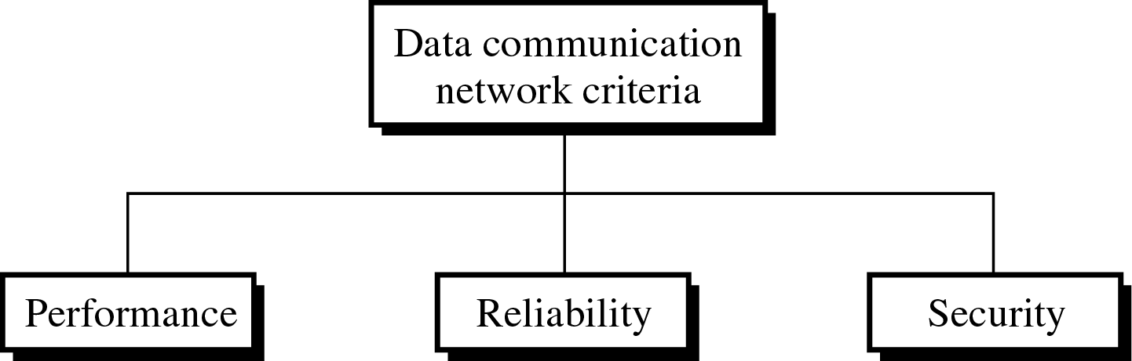
Network Criteria
To be considered effective and efficient, a network must meet a number of criteria: Performance, Reliability, and Security.
Performance : Can be measured in transmit time and response time. Performance of a network depends on a number of factors: users, transmission medium, capabilities of connected hardware and the efficiency of software.
Reliability : Improving reliability is usually related to various bugs fixes for applications and technologies that result in a better functioning. For example, announcements of Apple or Microsoft about new OS updates with “enhanced functionality and improved reliability”.
Security: The security issue often deals with vulnerabilities of a system. OS bugs that make the system vulnerable to an attack are usually discussed.
Network:
A set of devices (nodes) connected by communication links.
Most network uses distributed processing.

Slide 21
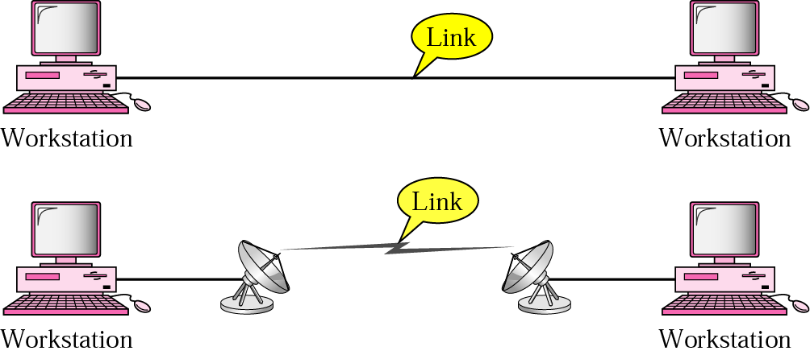
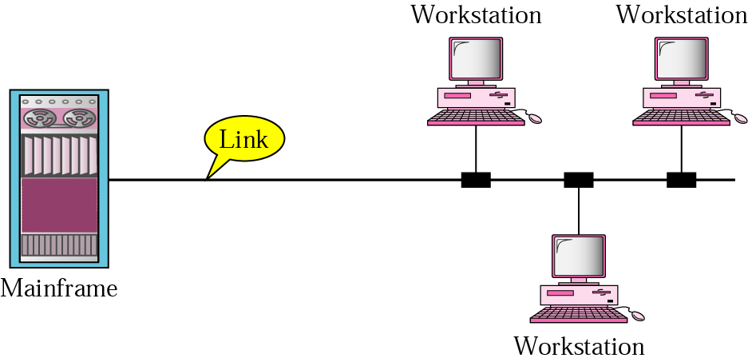
Type of Connection - Point-to-Point & Multipoint
Dedicated link between two devices
The entire capacity of the channel is reserved
Ex) Microwave link, TV remote control
More than two devices share a single link
Capacity of the channel is either
Spatially shared: Devices can use the link simultaneously
Timeshare: Users take turns

Slide 22
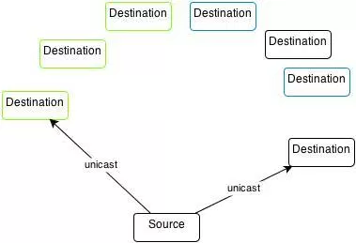
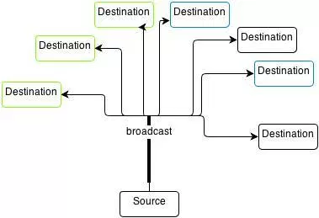
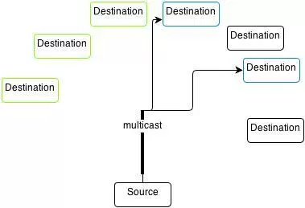
Unicast/Broadcast/Multicast
Three different methods of sending messages over computer networks:
Unicast - Using unicast method, one device will send the message to exactly one destination device.
Broadcast - Broadcast is a packet that’s sent to all devices on specific network.
Multicast - Multicasting identifies logical groups. A single message can then be sent to the group.

Slide 23
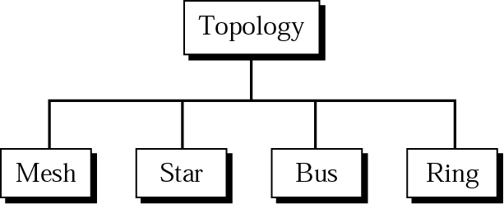
Physical Topology

Slide 24
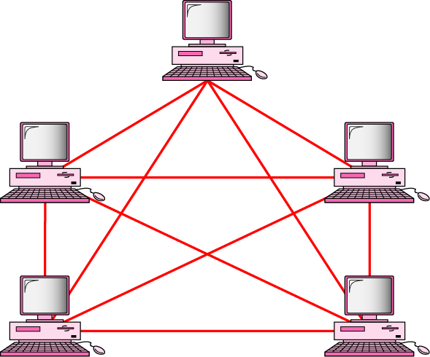
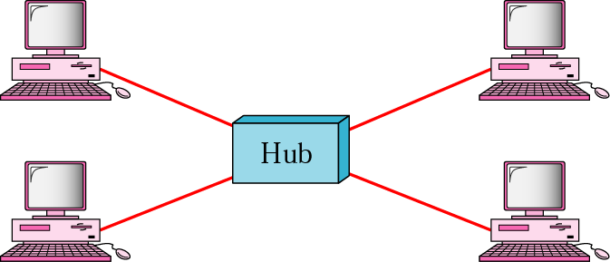
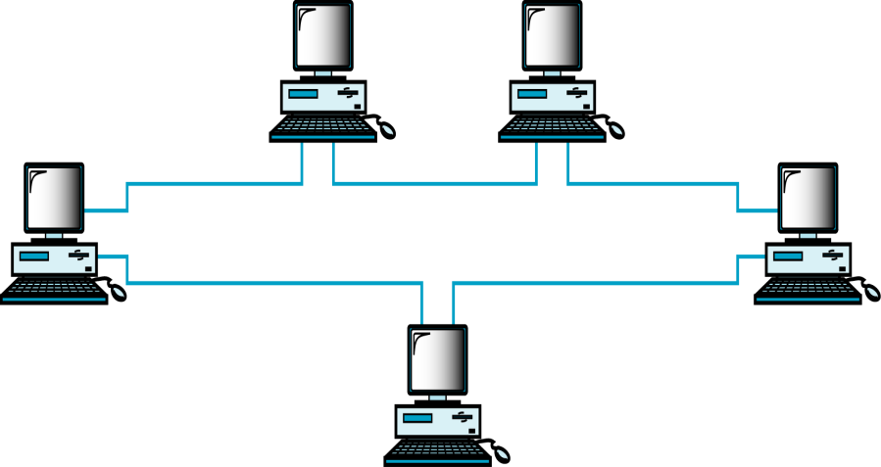
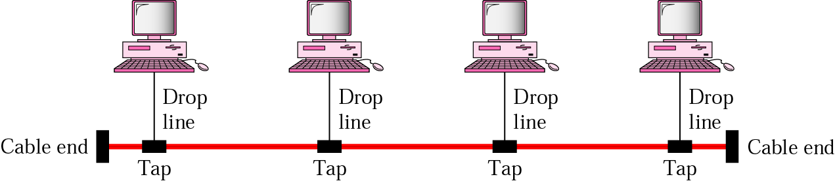
Mesh Dedicated point-to-point link between each devices
Star
Dedicated point-to-point link to Central Controller (Hub)
Ring Dedicated point-to-point link only with the two nodes on each sides
BUS
One long cable that links all nodes
Notes:
Dedicated point-to-point link between each devices - MESH
Dedicated point-to-point link only to a central controller, called a hub - STAR
One long cable that links all nodes - BUS
Dedicated point-to-point link only with the two nodes on each sides – RING

Slide 25
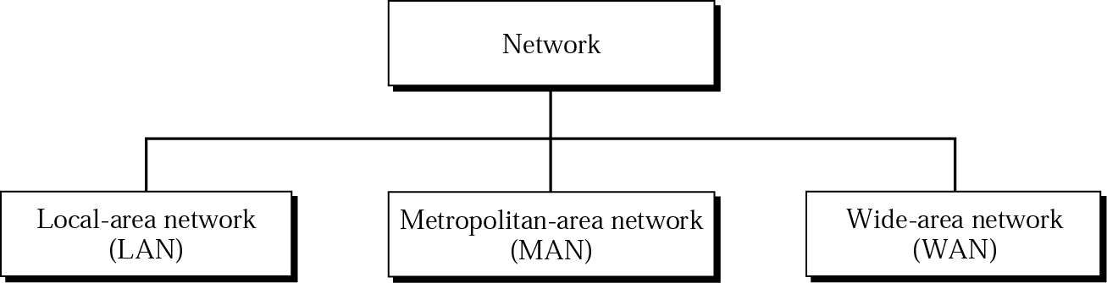
Categories of Networks

Slide 26
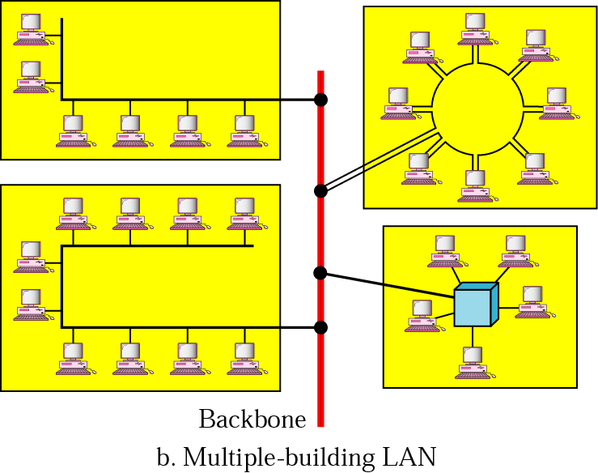
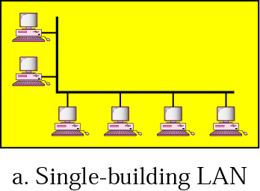
LAN
Usually privately owned
A network for a single office, building, or campus ≤ a few Km
Common LAN topologies: bus, ring, star

Slide 27
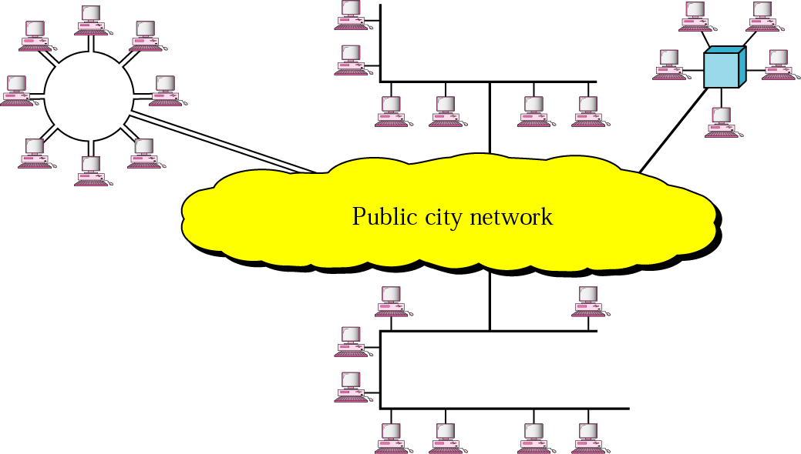
MAN
Designed to extend to an entire city
Cable TV network, a company’s connected LANs
Owned by a private or a public company

Slide 28
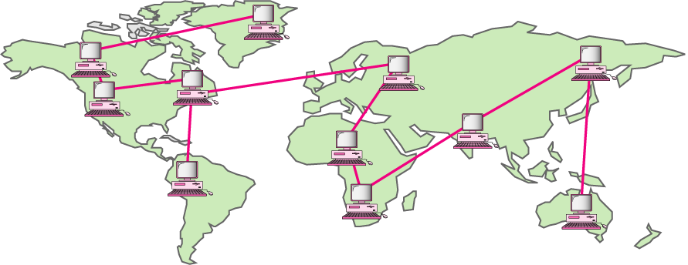
WAN
Long distance transmission, e.g., a country, a continent, the whole world
Enterprise network: A WAN that is owned and used by a single company

Slide 30
Wide Area Networks (WANs)
Generally covers a large geographical area
Require the crossing of public right-of-ways
Rely at least in part on circuits provided by one or more common carriers —companies
Typically consist of a number of interconnected switching nodes
A trans-mission from any one device is routed through these internal nodes to the specified destination device.
Notes:
Wide area networks generally cover a large geographical area. They often require
the crossing of public right-of-ways, and typically rely at least in part on circuits
provided by one or more common carriers —companies that offer communication
services to the general public. Typically, a WAN consists of a number of interconnected
switching nodes. A trans-mission from any one device is routed through
these internal nodes to the specified destination device. These nodes (including the
boundary nodes) are not concerned with the content of the data; rather, their purpose
is to provide a switching facility that will move the data from node to node
until they reach their destination.

Slide 31
Traditionally, Wide Area Networks have been implemented using one of two technologies:
Circuit switching
Packet switching
Subsequently, the following two played major roles
Frame relay
Asynchronous Transfer Mode (ATM)
❖ Gradually being supplanted by services based on gigabit
Ethernet and Internet Protocol technologies.
Notes:
Traditionally, WANs have been implemented using one of two technologies:
circuit switching and packet switching. Subsequently, frame relay and ATM networks
assumed major roles. While ATM and, to some extent frame relay, are still
widely used, their use is gradually being supplanted by services based on gigabit
Ethernet and Internet Protocol technologies.

Slide 32
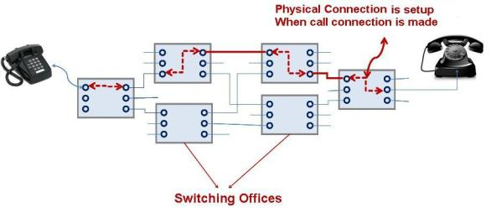
Circuit Switching
A dedicated communications path is established between two stations through the nodes of the network
The path is connected sequence of physical links between nodes
On each link, a logical channel is dedicated to the connection
Data generated by the source station are transmitted along the dedicated path as rapidly as possible.
The most common example of circuit switching is the telephone network
Notes:
In a circuit-switching network, a dedicated communications
path is established between two stations through the nodes of the network. That
path is a connected sequence of physical links between nodes. On each link, a logical
channel is dedicated to the connection. Data generated by the source station are
transmitted along the dedicated path as rapidly as possible. At each node, incoming
data are routed or switched to the appropriate outgoing channel without delay. The
most common example of circuit switching is the telephone network.

Slide 33
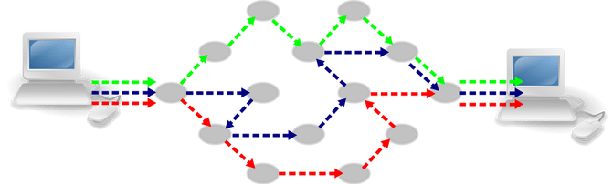
Packet Switching
It is NOT necessary to dedicate transmission capacity along a path through the network.
Data are sent out in a sequence of small chunks called packets
Packets are passed from node to node along SOME path leading from source to destination
Packet-switching networks are commonly used for terminal-to-computer and computer-to-computer communications
The Internet is based on a packet-switching protocol, TCP/IP.
Notes:
In a packet-switching network, it is not necessary to dedicate
transmission capacity along a path through the network. Rather, data are sent out
in a sequence of small chunks, called packets. Each packet is passed through the
network from node to node along some path leading from source to destination. At
each node, the entire packet is received, stored briefly, and then transmitted to the
next node. Packet-switching networks are commonly used for terminal-to-computer
and computer-to-computer communications.

Slide 34
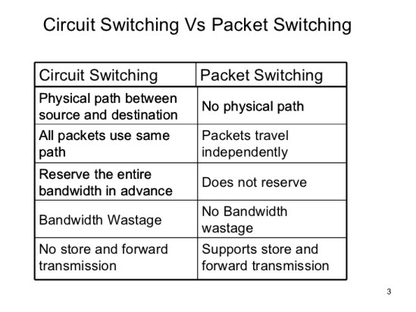

Slide 35
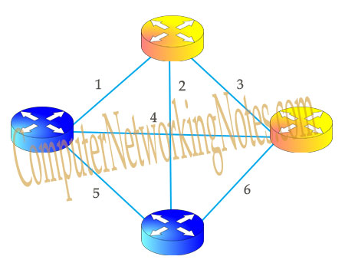
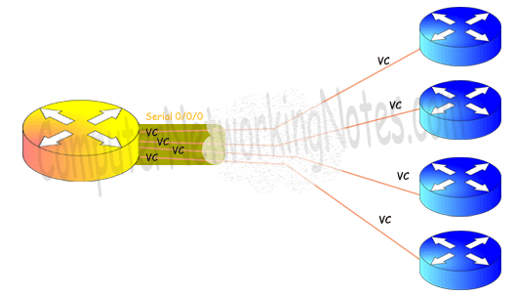
Frame Relay
Packet switching was developed at a time when digital long-distance transmission facilities exhibited a relatively high error rate compared to today’s facilities.
There is a considerable amount of overhead built into packet-switching schemes to compensate for errors.
Developed to take advantage of high data rates and low error rates
Operates at data rates of up to 2 Mbps
Key to achieving high data rates is to strip out most of the overhead involved with error control
Required No. of connections:
(N × (N – 1)) / 2
[Here N is the number of routers]
We need (4 x (4-1)) /2 = 6 leased lines.
Notes:
https://www.computernetworkingnotes.com/ccna-study-guide/basic-concepts-of-frame-relay-explained-in-easy-language.html
If we have 100 routers then we need (100 x (100-1)) /2 = 4950 lease lines and 99 serial interfaces on each router. Forget about low end routers, even a 7700 series router does not have sufficient physical interfaces to handle this requirement.
Here comes Frame Relay. Frame Relay turns physical interface in virtual interfaces. With virtual interface Frame Relay can effectively handle this network or even bigger network with single serial interface. Have a look on following figure that illustrate above network with Frame Relay
Frame relay was developed to take advantage of these high data rates and low
error rates. Whereas the original packet-switching networks were designed with a
data rate to the end user of about 64 kbps, frame relay networks are designed to
operate efficiently at user data rates of up to 2 Mbps. The key to achieving these
high data rates is to strip out most of the overhead involved with error control.

Slide 36
Asynchronous Transfer Mode (ATM)
Referred to as cell relay. ATM can be viewed as an evolution from frame relay.
Culmination of developments in circuit switching and packet switching
Uses fixed-length packets called cells (Reduced Overhead)
Works in range of 10s and 100s of Mbps and in the Gbps range
Allows multiple channels with the data rate on each channel dynamically set on demand
ATM creates fixed routes between two points before data transfer begins (TCP/IP - data is divided into packets, each of which takes a different route to get to its destination).
Notes:
Asynchronous transfer mode, sometimes referred to as cell relay, is a culmination
of developments in circuit switching and packet switching. ATM can be
viewed as an evolution from frame relay. The most obvious difference between
frame relay and ATM is that frame relay uses variable-length packets, called
frames, and ATM uses fixed-length packets, called cells. As with frame relay, ATM
provides little overhead for error control, depending on the inherent reliability of
the transmission system and on higher layers of logic in the end systems to catch and
correct errors. By using a fixed packet length, the processing overhead is reduced
even further for ATM compared to frame relay. The result is that ATM is designed
to work in the range of 10s and 100s of Mbps, and in the Gbps range.
ATM can also be viewed as an evolution from circuit switching. With circuit
switching, only fixed-data-rate circuits are available to the end system. ATM allows
the definition of multiple virtual channels with data rates that are dynamically
defined at the time the virtual channel is created. By using small, fixed-size cells,
ATM is so efficient that it can offer a constant-data-rate channel even though it is
using a packet-switching technique. Thus, ATM extends circuit switching to allow
multiple channels with the data rate on each channel dynamically set on demand.

Slide 37
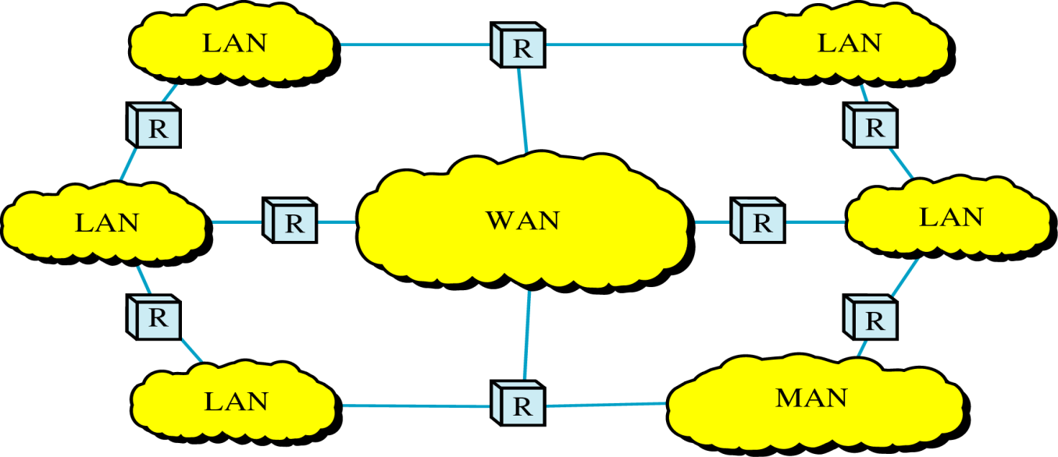
Internetworks
Internetwork (internet) : two or more networks are connected by internetworking devices
Internetworking devices: router, gateway, etc.
The Internet: a specific worldwide network

Slide 38
The Internet
Internet evolved from ARPANET, developed in 1969 by the Advanced Research Projects Agency (ARPA) of the U.S. Department of Defense (DoD).
First operational packet-switching network
Applied to tactical radio communication (packet radio) and to satellite communication (SATNET)
Had a need for interoperability
Led to standardized TCP/IP protocols
Notes:
The Internet evolved from the ARPANET, developed in 1969 by the Advanced Research Projects Agency (ARPA) of the U.S. Department of Defense. It was the first operational packet-switching network. The network was so successful that ARPA applied the same packet-switching technology to tactical radio communication (packet radio) and to satellite communication (SATNET). The need for interworking between these led to Vint Cerf and Bob Kahn of ARPA developing methods and protocols for such internetworking, which led eventually to the development of TCP/IP.

Slide 39
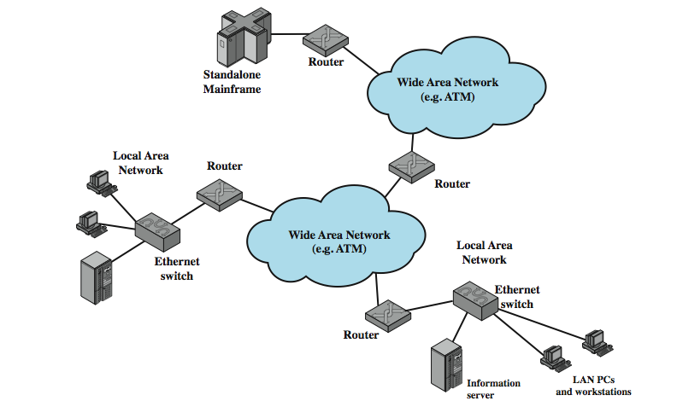
Internet Elements
Figure illustrates - the key elements of Internet e.g. PCs, workstations, servers, mainframes.
Most hosts that use the Internet are connected to a network e.g., local area network (LAN) or a wide area network (WAN). These networks are in turn connected by routers.
Notes:
Stallings DCC8e Figure 1.4 illustrates the key elements that comprise the Internet, whose purpose is to interconnect end systems, called hosts; including PCs, workstations, servers, mainframes, and so on. Most hosts that use the Internet are connected to a network, such as a local area network (LAN) or a wide area network (WAN). These networks are in turn connected by routers.

Slide 40
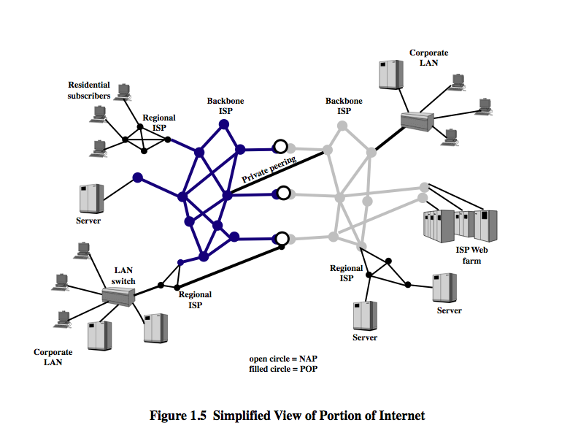
Internet Architecture
The Internet today is made up of thousands of overlapping hierarchical networks.
Hosts grouped into LANs, linked to an Internet service provider (ISP) through a point of presence (POP).
The connection is made in a series of steps starting with the customer premises equipment (CPE).
ISPs can be classified as backbone or regional, with peering links between.
Notes:
The Internet today is made up of thousands of overlapping hierarchical networks, an overview of the common, general characteristics can be made. Stallings DCC8e Figure 1.5 illustrates this. See hosts grouped into LANs, linked to an an Internet service provider (ISP) through a point of presence (POP). The connection is made in a series of steps starting with the customer premises equipment (CPE). ISPs can be classified as regional or backbone, with peering links between.

Slide 41
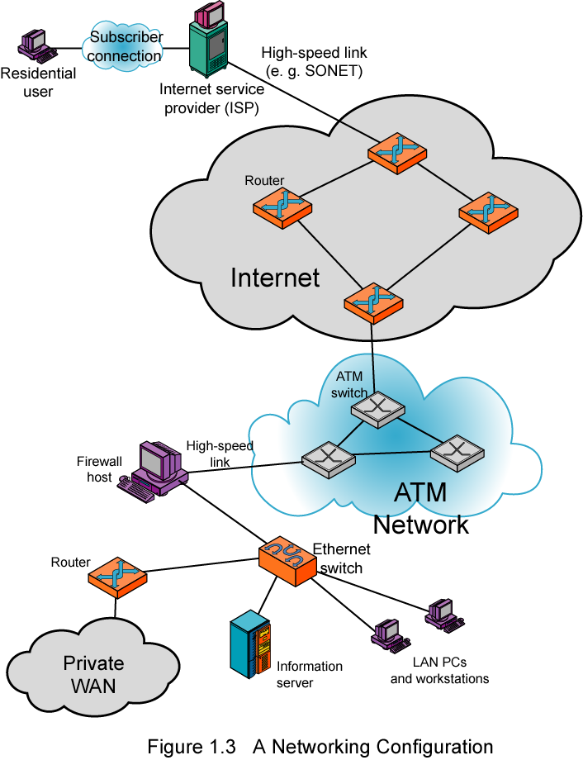
Example Configuration
Illustrates some of the typical communications and network elements in use today.
In the upper-left-hand portion of the figure, we see an individual residential user connected to an Internet service provider (ISP) through some sort of subscriber connection.
The Internet consists of a number of interconnected routers that span the globe. The routers forward packets of data from source to destination through the Internet.
The lower portion shows a LAN implemented using a single Ethernet switch, eg. small business or organization.
Notes:
Stallings DCC8e Figure 1.6 illustrates some of the typical communications and network elements in use today. In the upper-left-hand portion of the figure, we see an individual residential user connected to an Internet service provider (ISP) through some sort of subscriber connection. The Internet consists of a number of interconnected routers that span the globe. The routers forward packets of data from source to destination through the Internet. The lower portion shows a LAN implemented using a single Ethernet switch. This is a common configuration at a small business or other small organization.

Slide 42
Summary
Data and Data Communication
Data Communication Model
Direction of Data Flow
Topology
Categories of Network
Internet

Slide 44
Thank You

